Slide 1
Communal Discernment Part I: Context and Consciousness
Mary Pellegrino, CSJ
Transformation of Religious Life in North America:
An Action-Oriented Initiative

Slide 2
A Working Definition
Communal Discernment:
Process undertaken by a community as a community to discover God’s desire/direction within a particular set of circumstances leading to some sort of action by the discerning community.
Shared work
Seeking God
Here and now
Expressed in action

Slide 3
Historical practice
Scripture:
oracles, divination, signs, dreams
Prophets, early Christian community: question of circumcision, establishment of diaconate
Desert Elders
Spiritual traditions: Benedictine, Ignatian, Quaker
Varied experiences and practices among us

Slide 4
Evolution of the practice
The practice of discernment has evolved as human consciousness has evolved
Human understanding and awareness of the Divine, the physical world (creation), human community, individual
What we know/understand today is vastly different from human knowledge/understanding thousands and even hundreds of years ago
Reading the signs of the times – both the signs and the times have changed over time

Slide 5
Discernment as act of justice
Justice = right relationships
Identity/vocation/commitments shape our relationships and vice versa
Discernment engages identity, mission, commitments in order to order relationships with others, self, creation, resources in God
Acts of personal and communal justice restore right ordering in relationships

Slide 6
Our obligation today
Engage the practice
with the broadest possible consciousness available,
the deepest understanding of reality (particular circumstances, signs of the times) available, and
the greatest freedom and availability to the Divine possible

Slide 7
Why consciousness matters
Consciousness and world view closely connected
Seismic shift in world view/consciousness is underway
Multiple world views/levels of consciousness operative at this time in history:
In our communities, church, country, world, etc
Discerning communities/bodies hold and are effected by this diversity

Slide 8
Emerging awareness: what poets and mystics have known all along
Creation is a unified whole – it is not made up of separate and discreet parts
Illusion of separateness – assumption of oneness
Union/unity is the organizing principle of universe; universe is organized relationally
Global and cosmic consciousness

Slide 9
Creation
First and primal sacrament
Icon of God: entryway into Mystery
On-going and evolutionary
Human community: consciousness of creation and co-creators with God

Slide 10
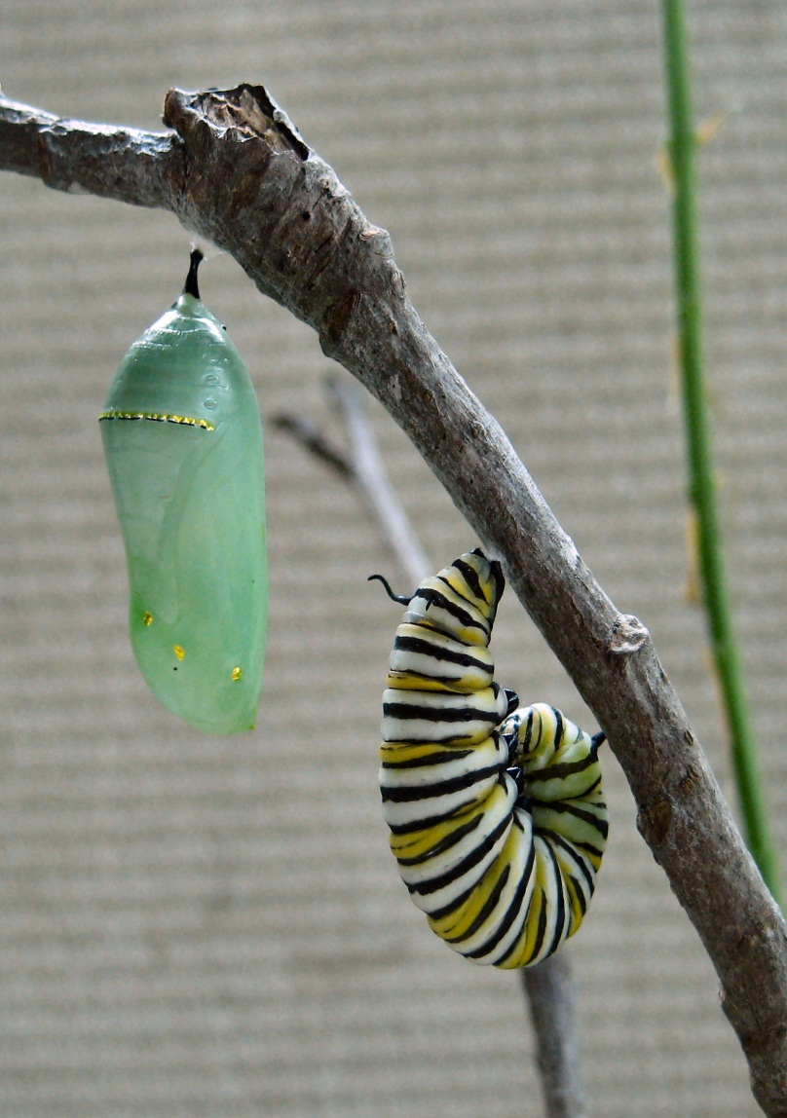
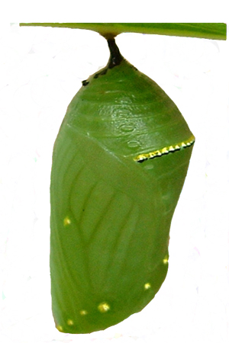
From Butterfly Soup. . .
Caterpillar’s imaginal disks carry
butterfly DNA
Imaginal disks begin to replicate; caterpillar treats them like foreign bodies
Imaginal disks achieve critical mass; caterpillar begins to “disintegrate” within the cocoon
Caterpillar liquefies into “butterfly soup”

Slide 11
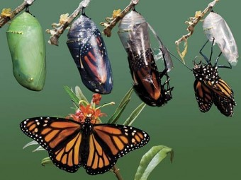
. . . royalty is born
Butterfly DNA continues to replicate until butterfly emerges from cocoon.

Slide 12
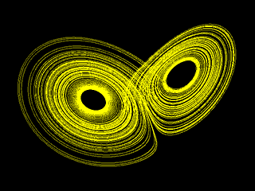

Slide 13
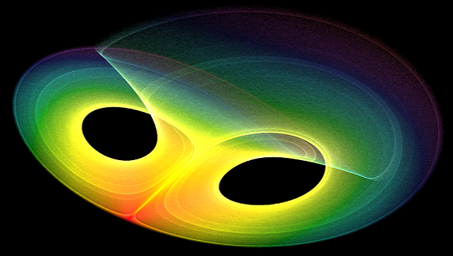

Slide 14
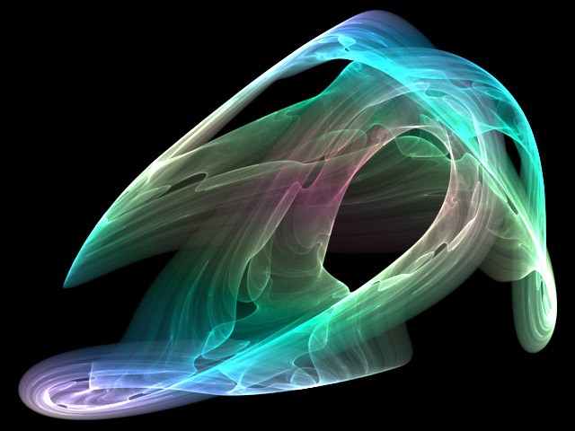

Slide 15
Strange Attractors: the shape of chaos
Strange attractors are the boundaries that contain chaos in the quantum world
Chaos describes the unpredictability within a system
Over time, chaos reveals its particular order; never exceeds its particular boundaries
Strange attractors (boundary, pattern, form) allow every seemingly chaotic (random) occurrence to contribute to the whole

Slide 16
Chaos and disequilibrium
Disequilibrium occurs when there is chaos in a system
In the natural world nothing new ever takes place in equilibrium
New life and new life forms only emerge when there is a high degree of instability in a system
The edge of chaos is the most creative region in nature

Slide 17
The edge of chaos
The further into disequilibrium a system goes the closer it moves to the edge of chaos
At the edge, there’s just enough stability to maintain structure and just enough dynamism (disequilibrium/disorder) to bring about something new

Slide 18
Context and Consciousness Matter
Dust as we are, the immortal spirit grows
Like harmony in music; there is a dark
Inscrutable workmanship that reconciles
Discordant elements, makes them cling together
In one society. How strange, that all
The terrors, pains, and early miseries,
Regrets, vexations, lassitudes interfused
Within my mind, should e'er have borne a part,
And that a needful part, in making up
The calm existence that is mine when I
Am worthy of myself!
William Wordsworth
The Prelude

